Slide 1
<code>

Slide 3
V
A
M
R

Slide 4
What?

Slide 5

XR

Slide 6
EQUIPMENT
[I] AUDIO [I] VISUALS
[I] HAND TRANSFORM
CONTROLLERS
CAMERA + MIC
SENSORS
[I] HEAD TRANSFORM
[O] VISUALS
HEADSET
VR
AR
[O] AUDIO
MR

Slide 7
Uses

Slide 8
VR
Training
Health
Entertainment
Education
Safety
Tourism
Showcase / Visualization
Therapy

Slide 9
AR/MR
Assistance
Education
Tourism
Showcase / Visualization

Slide 10
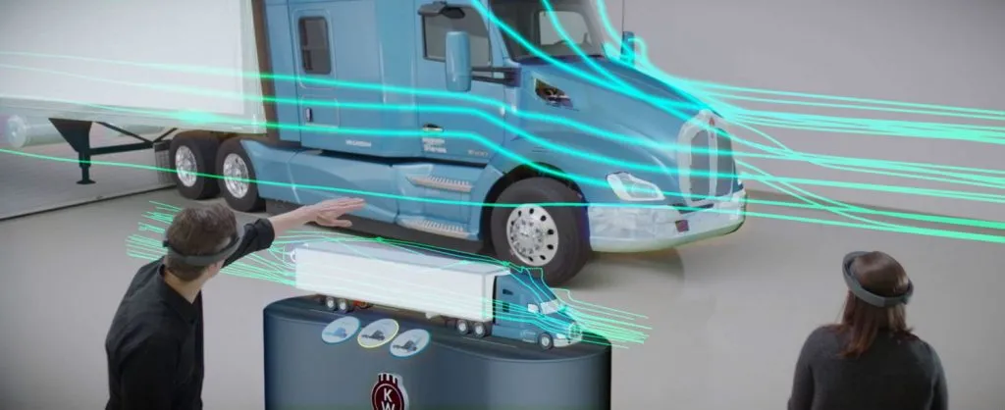

Slide 11


Slide 12
Development

Slide 13
STEREOPSIS

Slide 14
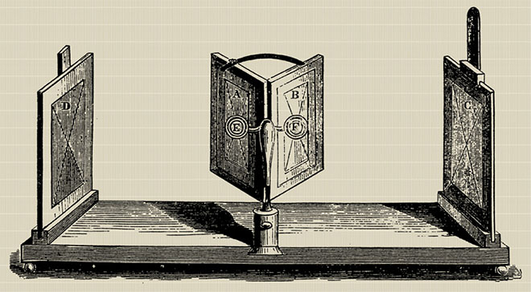
1838

Slide 15
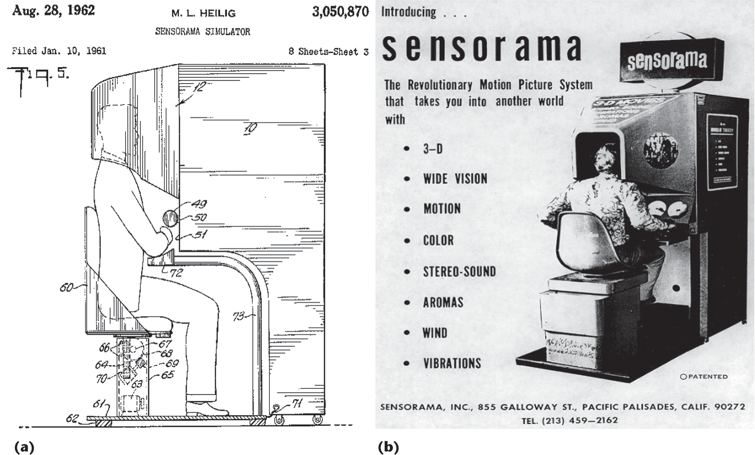

Slide 16
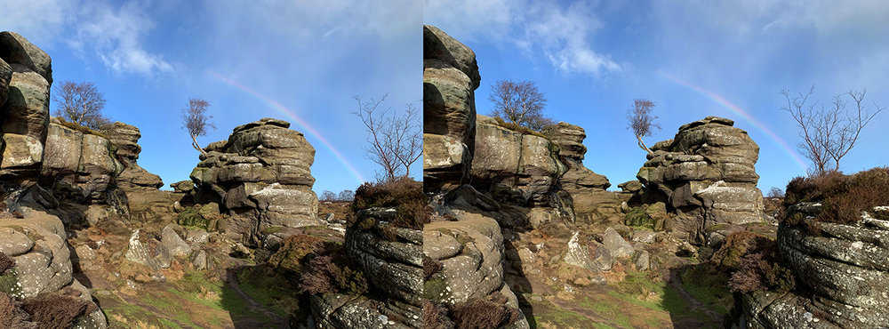
STEREOSCOPIC

Slide 17
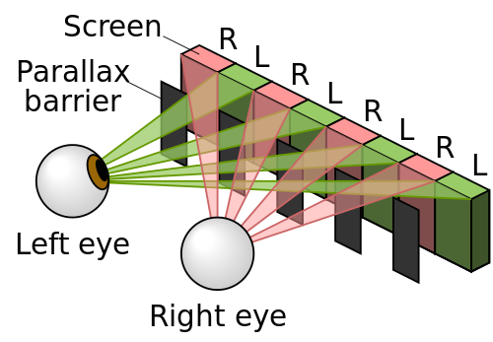

Slide 18
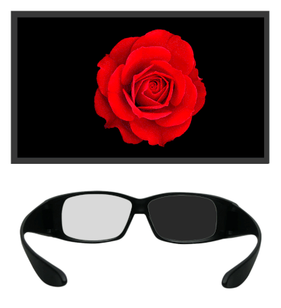

Slide 19
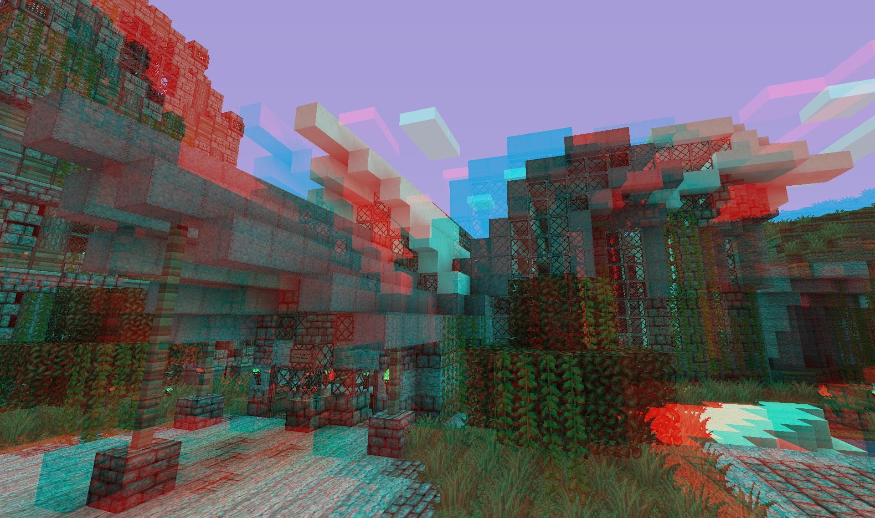
ANAGLYPH 3D

Slide 20
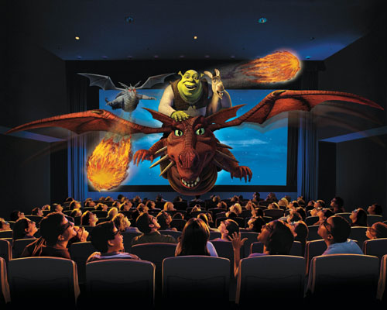
POLARIZED LIGHT

Slide 21

STEREOGRAM

Slide 22
Devices

Slide 23
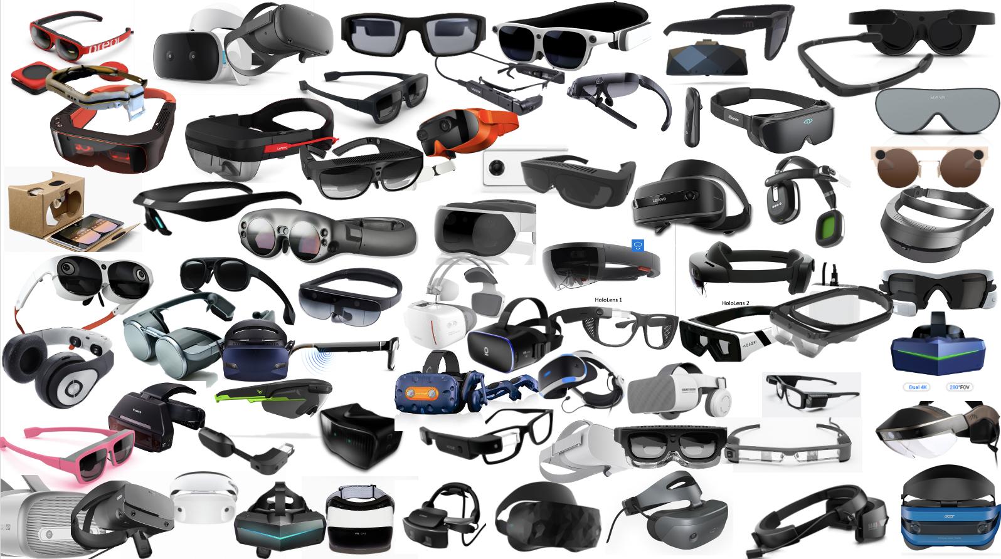

Slide 24
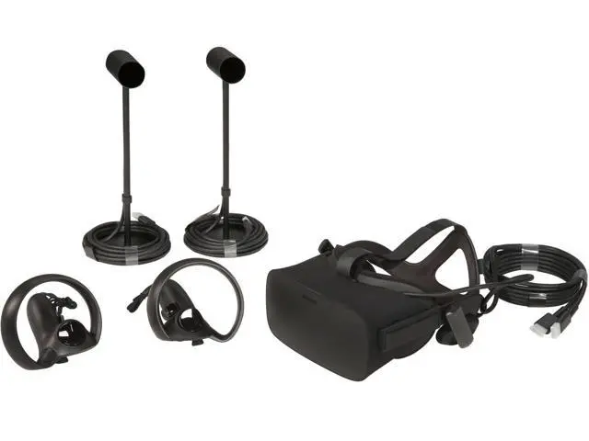
OCULUS RIFT
2016-03
600 $

Slide 25
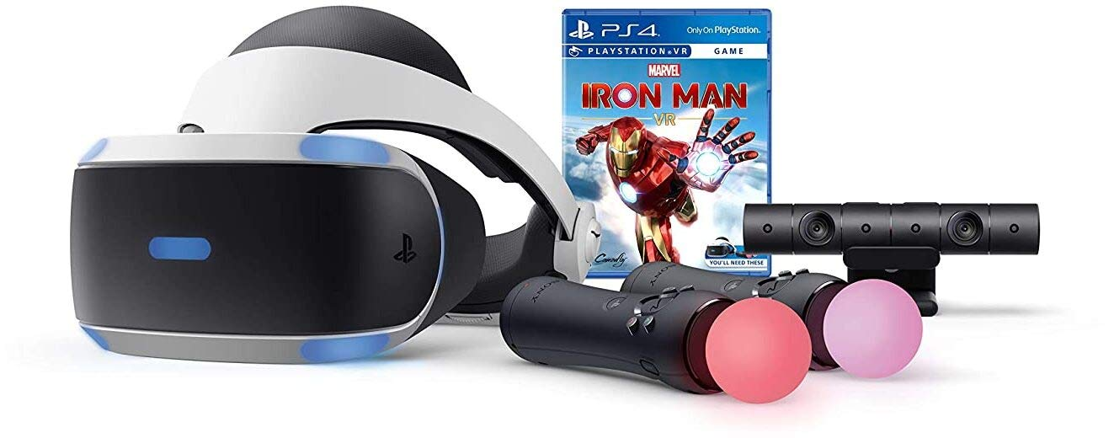
PSVR
2016-10
300-400 $

Slide 26
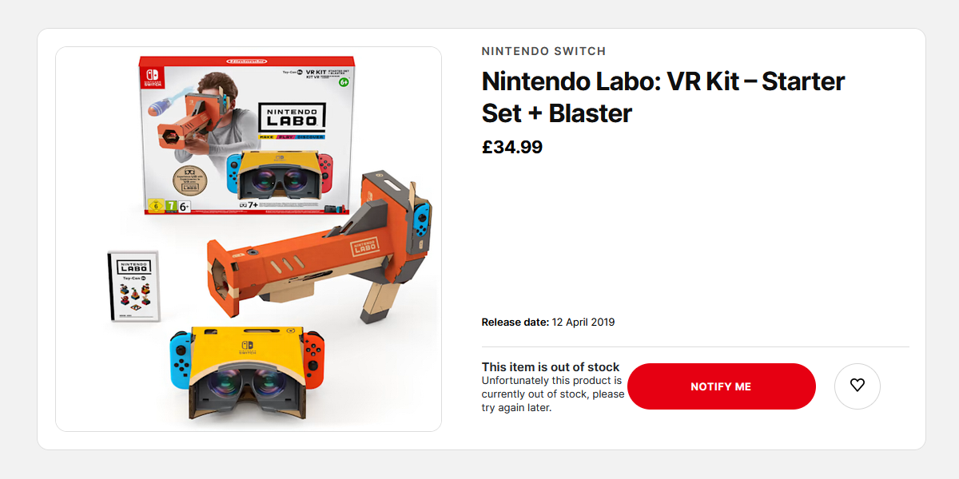
NINTENDO LABO VR
2019-04
~40€

Slide 27
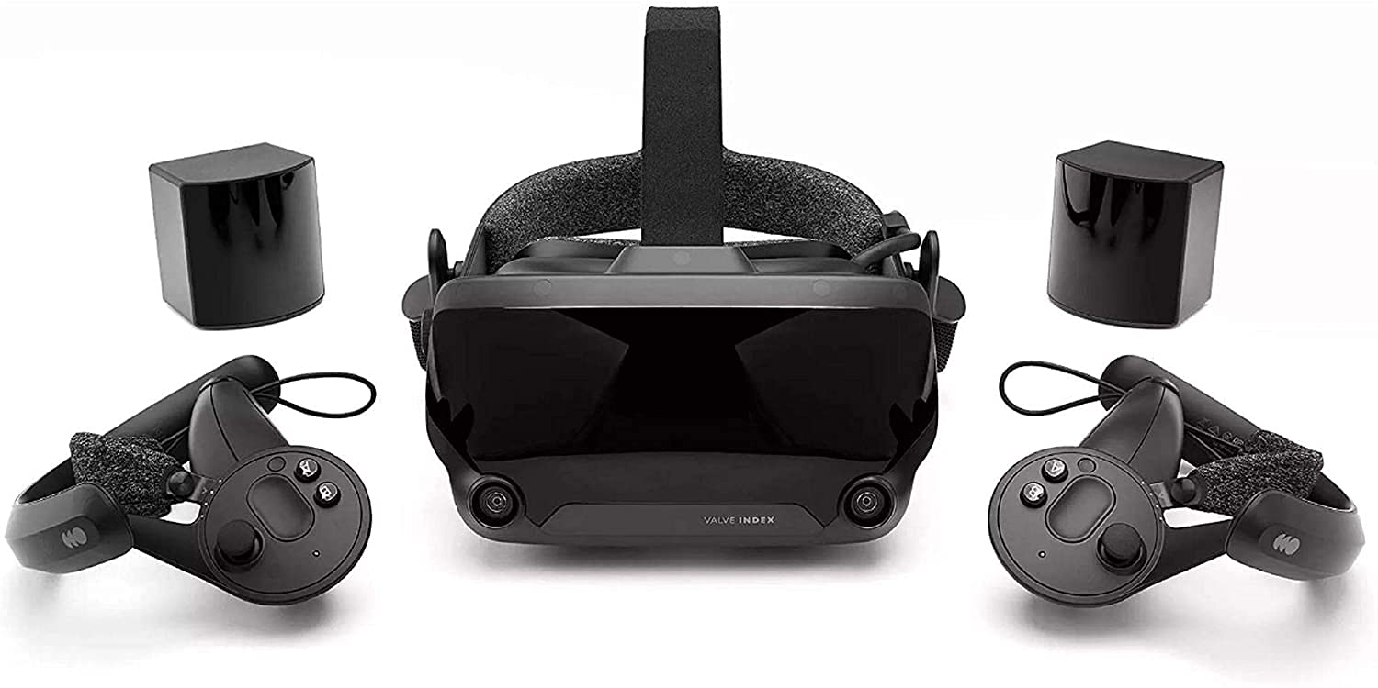
VALVE INDEX
2019-05
1079 €

Slide 28
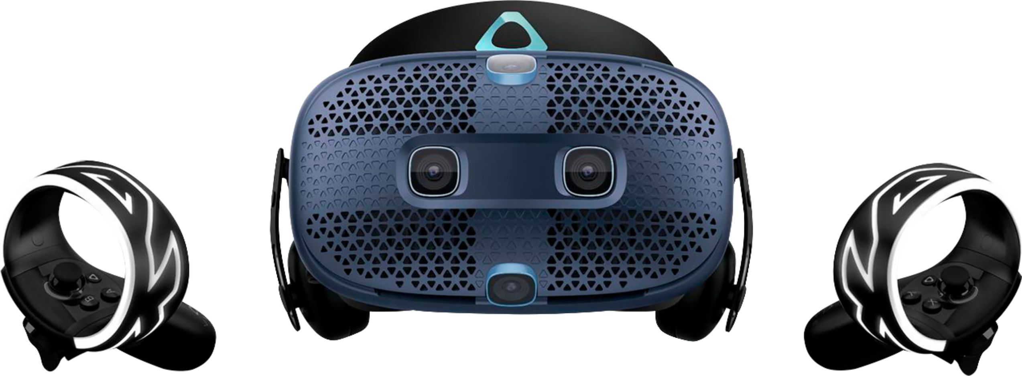
HTC VIVE COSMOS
2019-10
830 €

Slide 29
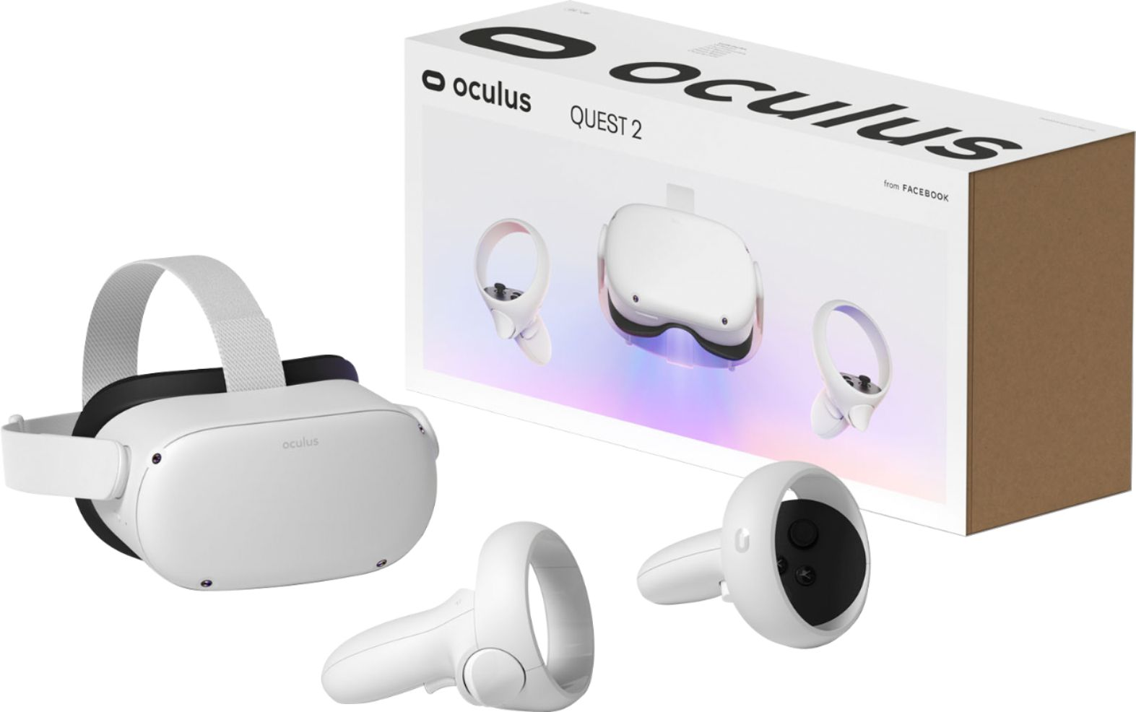
OCULUS QUEST 2
2020-10
300 $

Slide 30
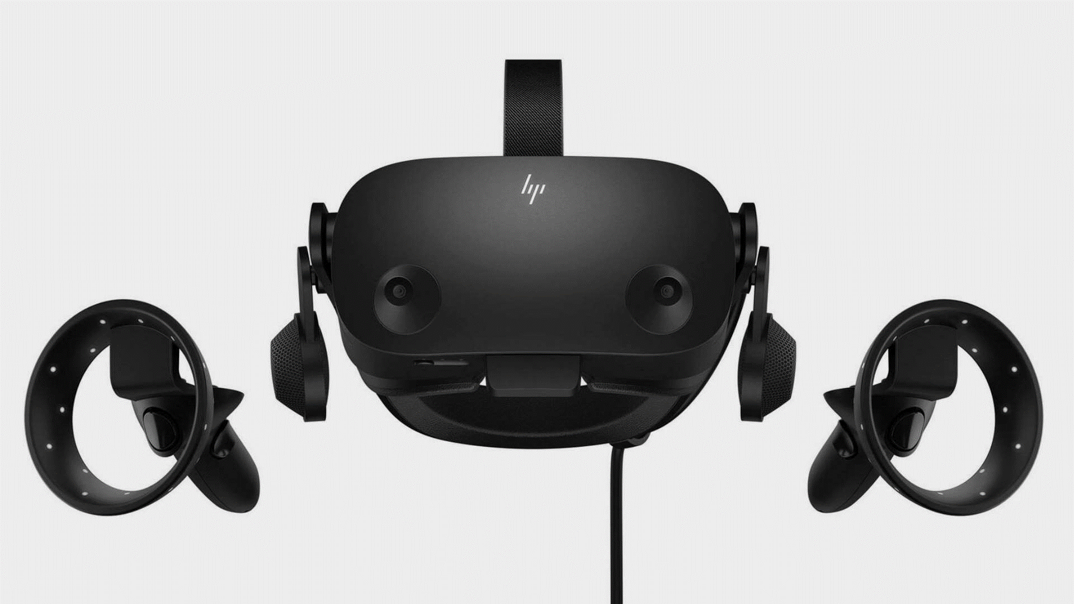
HP REVERB G2
2020-11
600 $

Slide 31
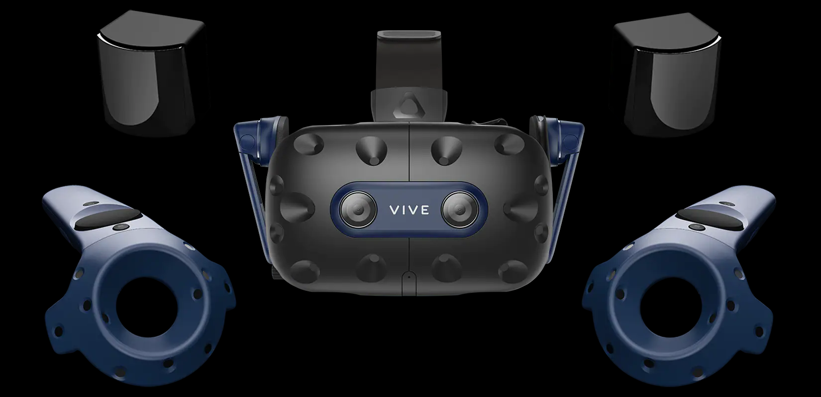
HTC VIVE PRO 2
2021-06
1440 €

Slide 32
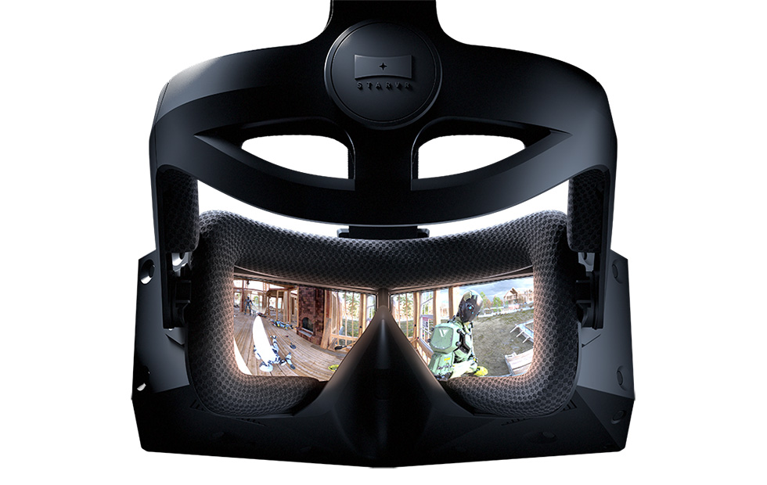
STARVR ONE
2018-08
3200 $

Slide 33
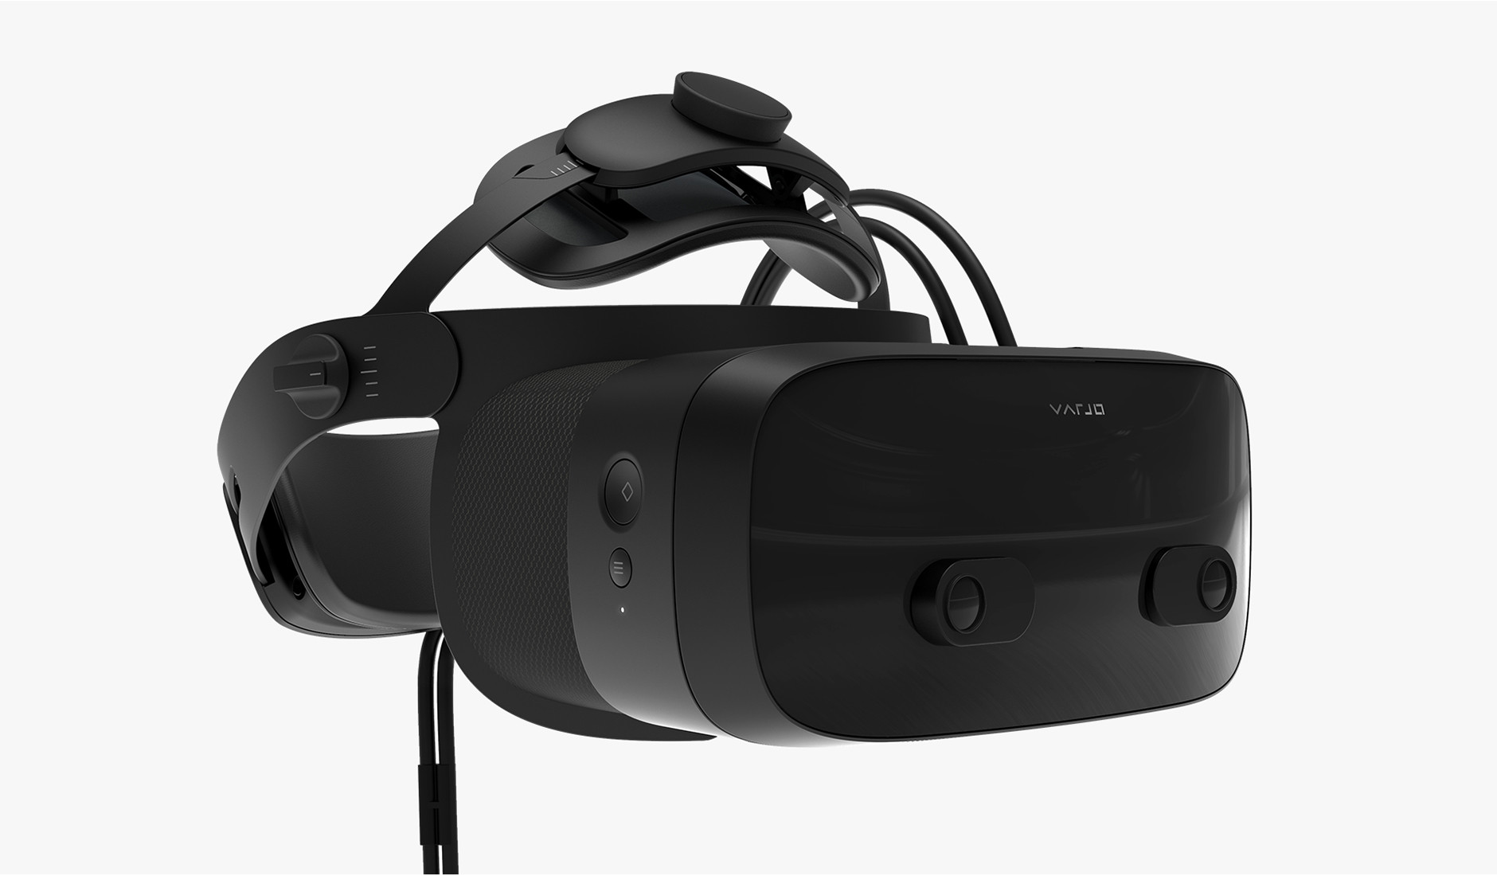
VARJO VR-3
2021-09
3200 $

Slide 34
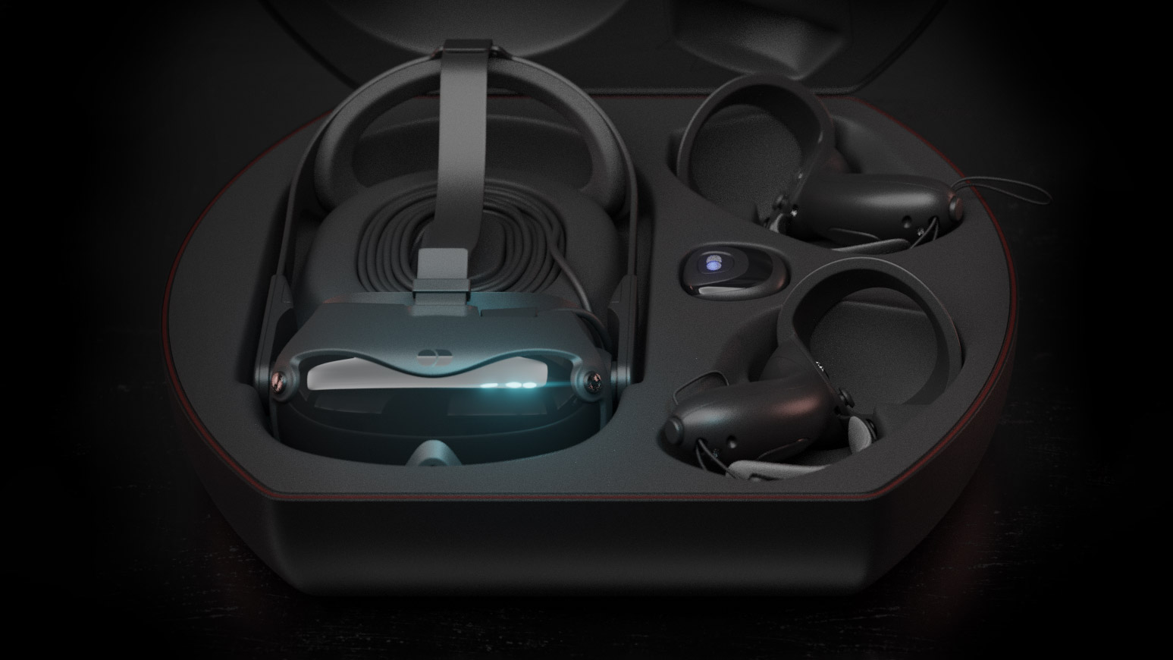
DECAGEAR 1
Q4 2022
450 $

Slide 35
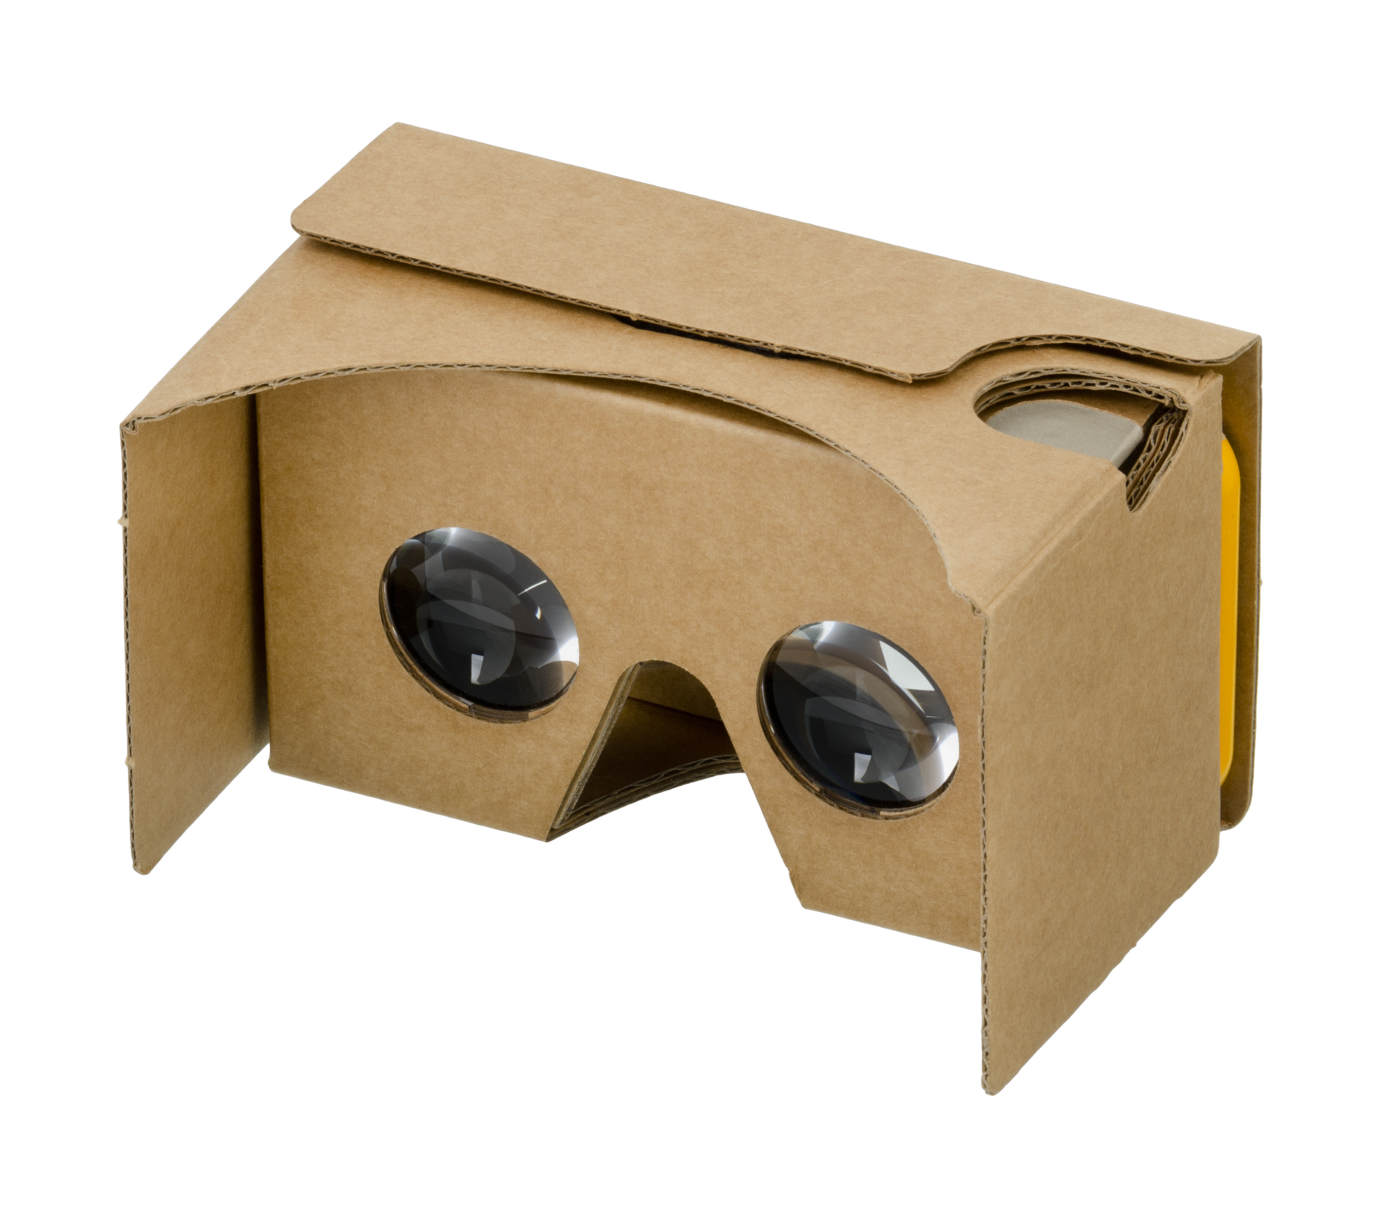
GOOGLE CARDBOARD
2014-06
2 $

Slide 36
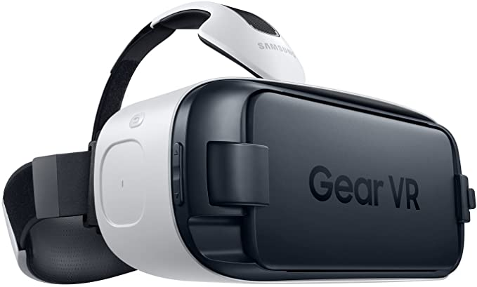
SAMSUNG GEAR VR
2015-11
130 $

Slide 37
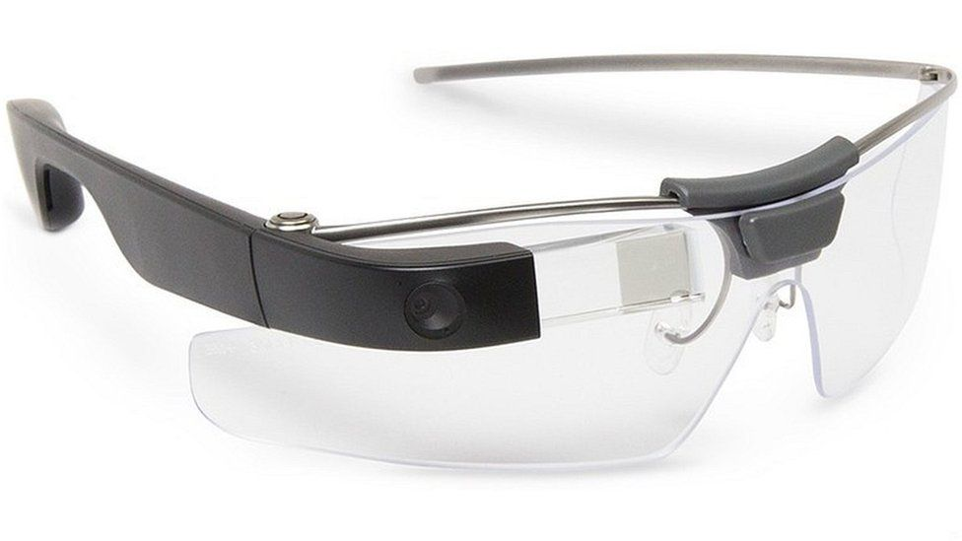
GOOGLE GLASS
2013/2014
1500 $

Slide 38
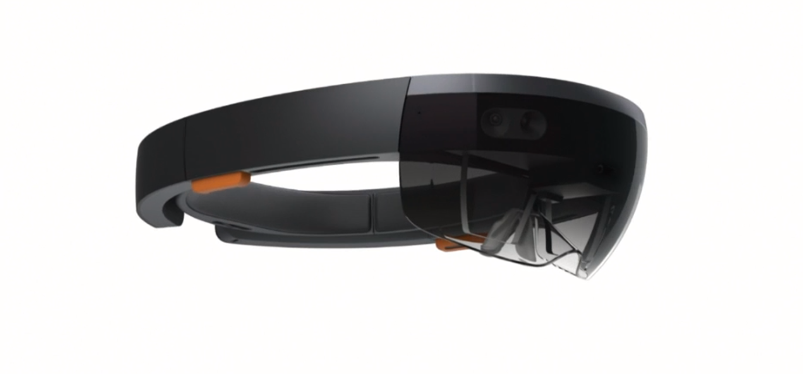
MICROSOFT HOLOLENS
2016-10
3000 $

Slide 39
Health

Slide 40
90Hz
Eye strain
Motion sickness
Injuries
(play area, sudden moves)
Escape from reality
Information overload

Slide 41
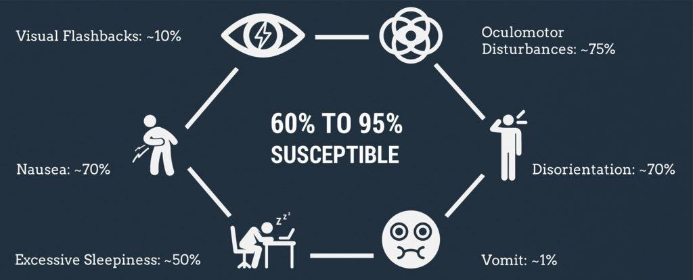

Slide 42
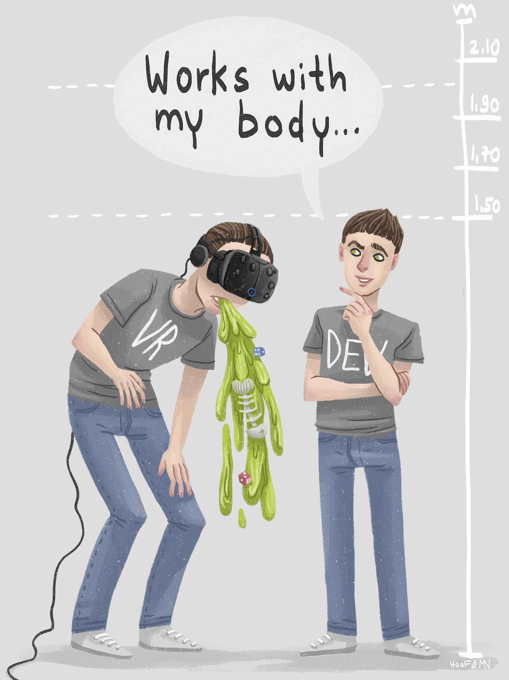
FLOOR HEIGHT

Slide 43
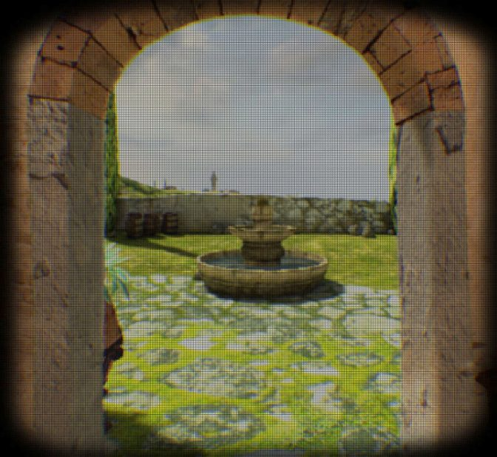
SCREEN DOOR EFFECT

Slide 44
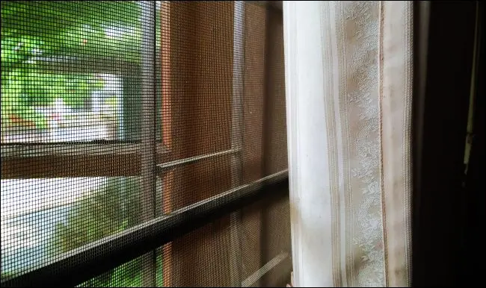

Slide 45
Game Engines & XR

Slide 46
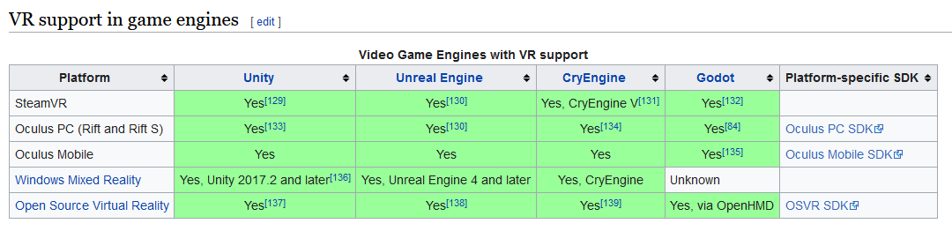
YES!

Slide 47
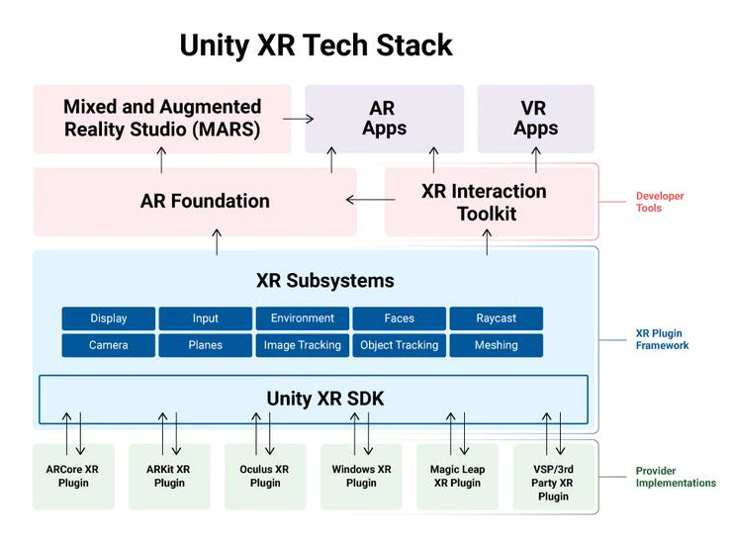
ARKit
ARCore
Microsoft HoloLens
Windows Mixed Reality
Magic Leap
Oculus
OpenXR
PlayStation VR
SteamVR

Slide 48
Optimization for VR

Slide 49
90Hz
2 screens
High resolution
Anti-Aliasing, ...

Slide 50
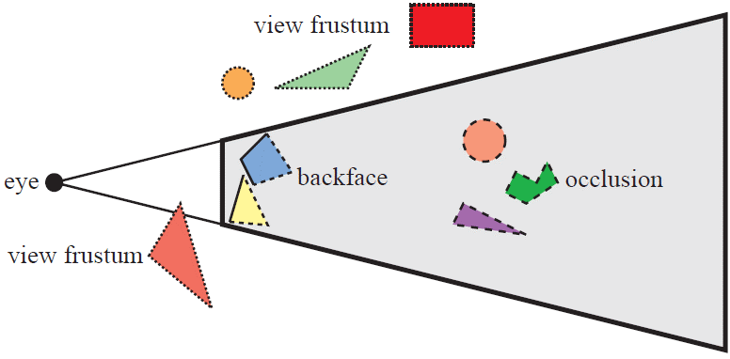
CULLING

Slide 51
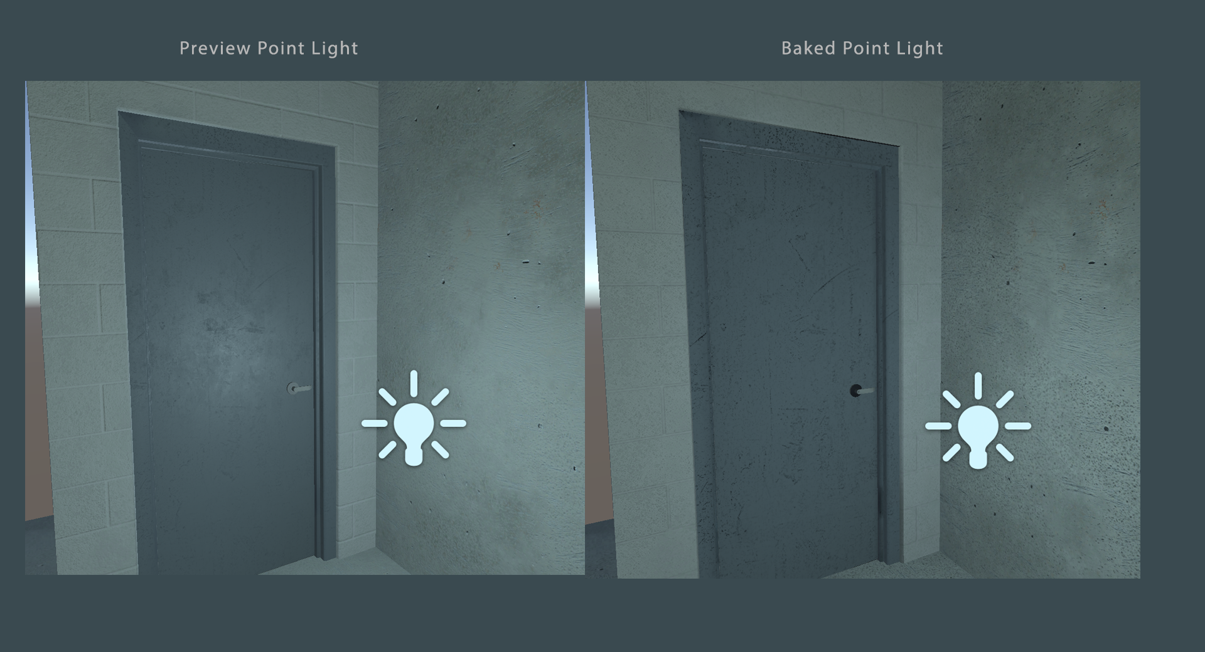
BAKING LIGHT & AMBIENT OCCLUSION

Slide 52
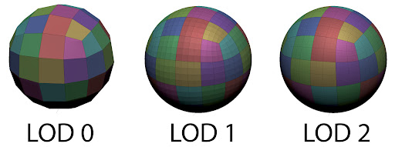
LOD

Slide 53
LOD

Slide 54
LOD

Slide 55
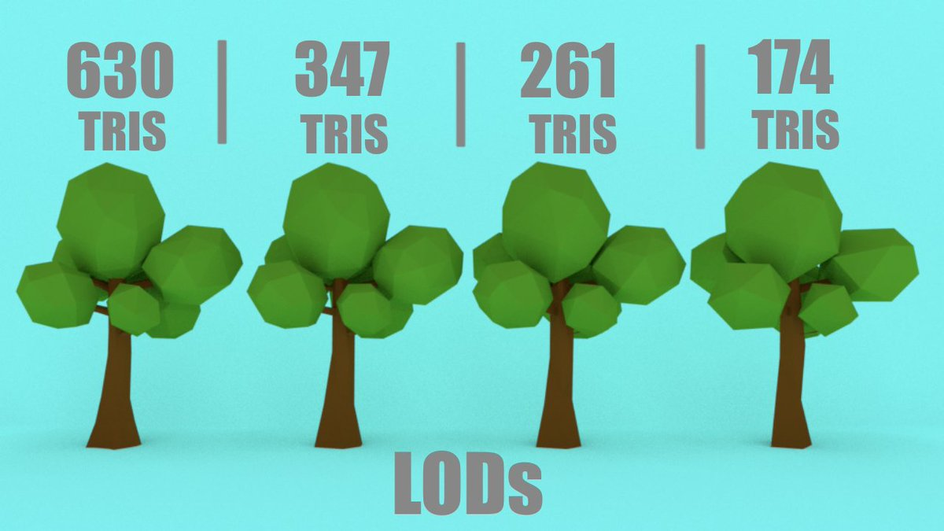

Slide 56
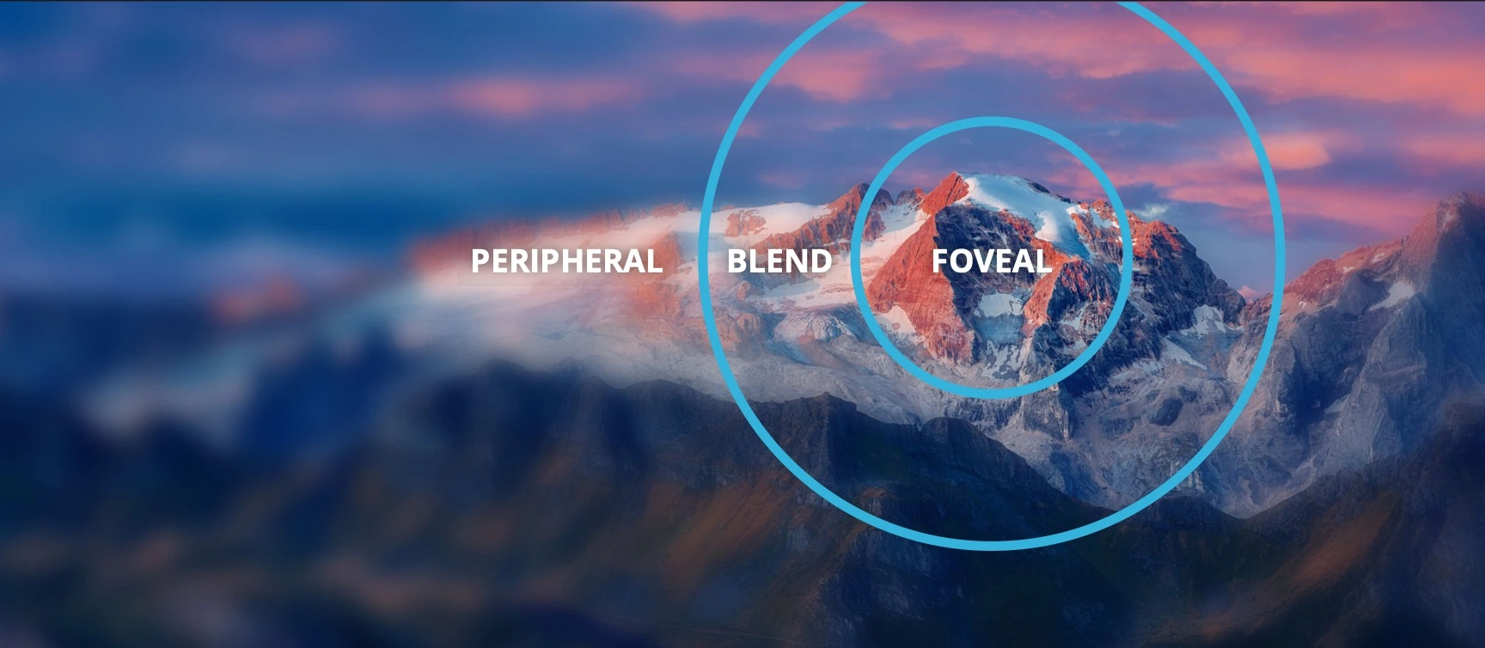
FOVEATED RENDERING

Slide 57
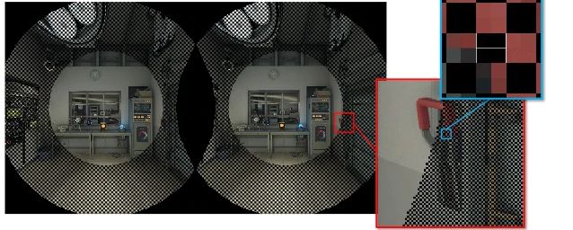
RADIAL DENSITY MASKING

Slide 58
Future

Slide 59
Smaller devices
Cheaper devices
Improved devices
Remote (work, events, ...)
Security
Social media
More hardware (senses)
5G
Less hardware (tracking)
Better AI
Navigation
Social acceptance

Slide 60
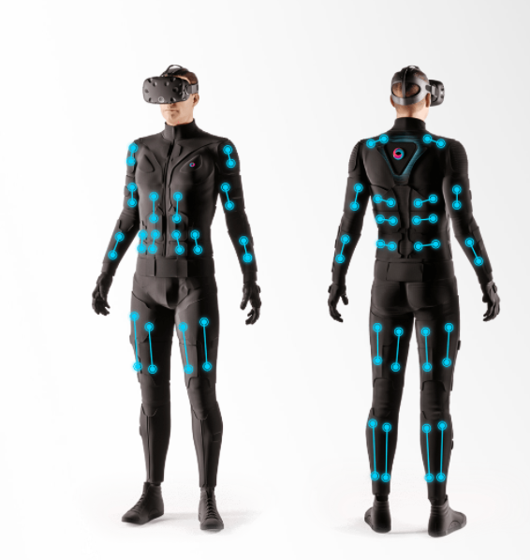
TESLASUIT
2
0
0
0
0
$

Slide 61
~ fin ~

